Slide 1


Customer Shopping Behavior Analysis
Uncovering insights from 3,900 purchases to guide strategic business decisions through data-driven analysis of spending patterns, customer segments, and product preferences.

Slide 2
DATASET OVERVIEW
The Foundation: Our Data
3,900
18
50
25
Total Purchases
Data Points
Locations
Products
Transactions analyzed across all categories
Features covering demographics and behavior
Geographic diversity in customer base
Unique items across four categories
Dataset includes customer demographics, purchase details, and shopping behavior metrics. Only 37 missing values found in Review Rating column.

Slide 3

Data Preparation in Python
01
Data Loading & Exploration
Imported dataset using pandas, checked structure with df.info() and summary statistics
02
Cleaning & Standardization
Imputed missing Review Ratings using median by category, renamed columns to snake_case
03
Feature Engineering
Created age_group bins and purchase_frequency_days columns for deeper analysis
04
Database Integration
Connected to PostgreSQL and loaded cleaned data for SQL analysis

Slide 4
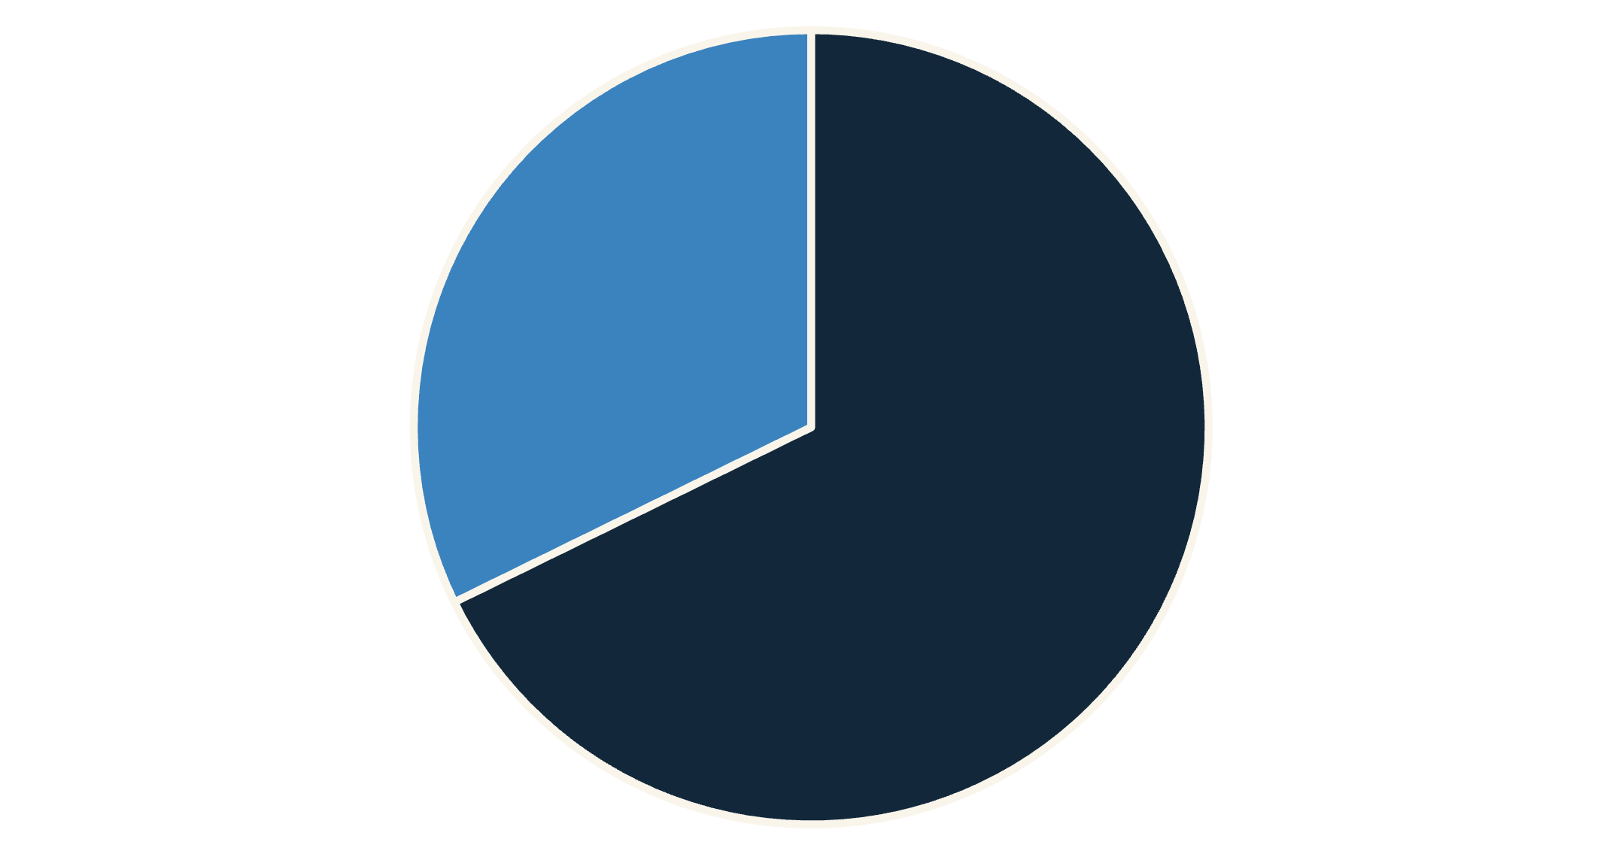
SQL ANALYSIS
Revenue Insights by Gender
Male Customers Drive Revenue
Male customers generated $157,890 in total revenue compared to $75,191 from female customers—representing 68% of total sales.
This significant difference suggests opportunities for targeted marketing strategies to better engage female shoppers.
Male
Female

Slide 5

Smart Discount Users
High-Value Discount Shoppers
Strategic Opportunity
Balanced Approach
These customers prove discounts can drive premium purchases without sacrificing revenue
Review discount policy to maximize sales while maintaining healthy profit margins
839 customers used discounts yet spent above the $60 average purchase amount

Slide 6
Top-Rated Products & Shipping Preferences
Highest-Rated Items
77%
77%
76%
Gloves
Sandals
Boots
3.86 average rating
3.84 average rating
3.82 average rating
Shipping Impact on Spend
Express Shipping: $60.48 average purchase
Standard Shipping: $58.46 average purchase
Express shipping customers spend 3.5% more on average, indicating higher-value customer segments prefer faster delivery options.

Slide 7

CUSTOMER SEGMENTS
Subscription Status Analysis
Subscription Opportunity
27%
73%
Subscribers
Non-Subscribers
1,053 customers
2,847 customers
Revenue Comparison
Subscribers: $62,645 total revenue, $59.49 average spend
Non-Subscribers: $170,436 total revenue, $59.87 average spend
Similar spending patterns suggest untapped potential to convert non-subscribers with exclusive benefits.

Slide 8

Customer Loyalty Breakdown
Loyal Customers
Returning Buyers
3,116 customers (80%) with strong purchase history and repeat behavior
701 customers (18%) showing moderate engagement and growth potential
New Customers
83 customers (2%) representing fresh acquisition opportunities
Among repeat buyers with 5+ purchases: 958 are subscribers while 2,518 are not—indicating significant subscription conversion potential.

Slide 9
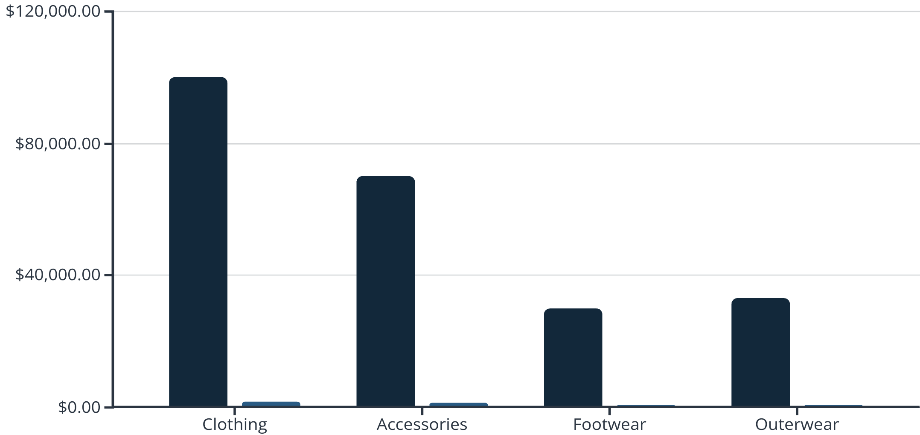
POWER BI DASHBOARD
Category Performance Overview
Key Dashboard Metrics
Average Purchase: $59.76 across all transactions
Average Rating: 3.75 out of 5.0 stars
Clothing dominates with 45% of sales volume and highest revenue. Young Adults lead revenue contribution at $62,143, followed by Middle-aged customers at $59,197.
Revenue
Sales Volume

Slide 10
Strategic Recommendations
Boost Subscriptions
1
Promote exclusive benefits to convert the 73% non-subscriber base with similar spending patterns
Loyalty Programs
2
Reward repeat buyers to move Returning customers into the Loyal segment
Optimize Discounts
3
Balance promotional sales with margin control—839 high-spenders prove discounts work
Product Positioning
4
Highlight top-rated items (Gloves, Sandals, Boots) and best-sellers in marketing campaigns
Targeted Marketing
5
Focus on Young Adults and express-shipping users who drive higher revenue per transaction

